Slide 1
NSWS, NSNA, and YOU!

Slide 2
2022-2023 Board Of Directors
President
Vice President
Secretary
Treasurer
Director East (2)
Director West (2)
Communications Director
Breakthrough to Nursing
Nominations Chair

Slide 3
About NSNA
Mission
Convey the standards and ethics of the nursing profession
Promote development of the skills that students will need as responsible and accountable members of the nursing profession
Advocate for high quality, evidence-based, affordable and accessible health care
Advocate for and contribute to advances in nursing education
Develop nursing students who are prepared to lead the profession in the future.
Founded in 1952
Core Values:
Advocacy
Leadership and Autonomy
Professionalism
Care
Diversity
Quality Education
Foundation of NSNA
Imprint

Slide 4
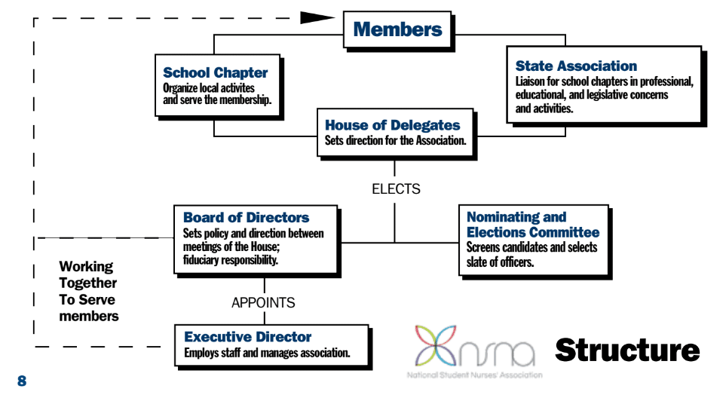

Slide 5
About NSWS
Originated in 2007 (formerly known as SWANS)
Mission: To develop a collaborate and cooperative structure between nursing schools within the state to create consistent high standards that support nursing students through education, scholarship, legislation, and networking.
NSWS is the state chapter of NSNA and an independent organization supported by the Washington State Nurses Association.
Purpose: To contribute collectively to the advancement of nursing education in order to promote the highest standards and best practices for nursing students in the state of Washington.
To build a cooperate structure between nursing schools and professional organizations within the state to provide programs and events that address fundamental and current professional interests and issues.
To encourage and support every nursing student in their personal and professional growth and to maintain a dialogue that allows for prioritization of issues and a common agenda.

Slide 6
How does membership work?
Membership Types
Active—students in ADN or BSN programs, or RN-BSN programs
Associate—students taking nursing school pre-requisites.
Can be on the NSWS Board but not as President or VP
Sustaining—not eligible for above membership; receive NSNA publications and reduced registration fees for NSNA events.
Membership in NSWS is automatic upon joining NSNA.
There is no process to join NSWS without joining NSNA.
We welcome input and involvement in school chapters and committees even if not a member of NSNA!
Total School Membership Plan
Total School Membership Plan (nsna.org)

Slide 7
Membership Benefits
NSNA
NSWS
Imprint magazine—5x per year
NSO—professional liability insurance
Health Insurance Marketplace
Wolters Kluwer discounts
Scrubs and Beyond
Littman—learning app
Healthstream—professional portfolio
Annual Convention
Associate membership in WSNA
Networking with fellow nursing students across the state!
Opportunities to learn and grow as a professional association member!

Slide 8
Where do you fit?
Run for NSWS office!
No experience necessary
Opportunity for personal and professional growth
Looks good on a resume ☺
Serve on a NSWS Committee
A great way to get involved
Encourage your school to create a NSWS/NSNA Chapter
Contact me for more info
Attend NSWS Meetings, Events, and Convention
Follow/share NSWS content on Social Media
Facebook
Instagram

